Slide 1
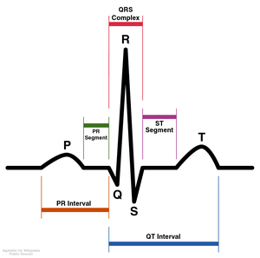
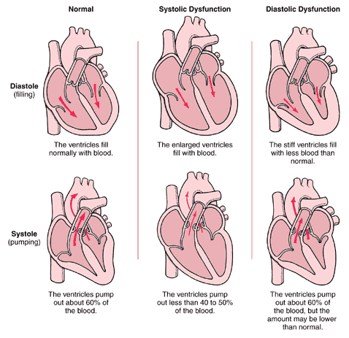
EGR111 Arrhythmia Project

Slide 2
This project is based on “Arrhythmia Detection Algorithms for Implantable Cardioverter Defibrillators” by Dr. Amy Bell
http://www.realworldengineering.org/index.php?page=project&project=233

Slide 3
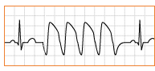
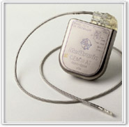
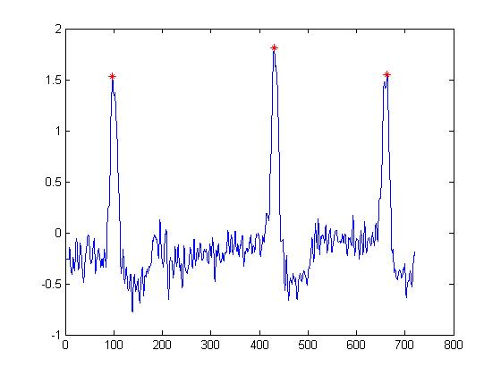
Outline This presentation will cover a brief description of the heart and arrhythmias, a history of solutions, the technical challenges of the solutions, and our project.
1. The heart
2. Heart Problems
3. Solutions
4. Technical challenges
5. Our Project

Slide 4
An average heart beats 100,000 times a day, pumping 2,000 gallons of blood through its chambers to the body and back to the heart.
An electrical impulse signals the heart’s four chambers to contract, pushing blood out through the body.
Then the heart relaxes.

Slide 5
The normal contract-relax cycle is called a Sinus Rhythm (SR)
This cycle follows a regular PQRST pattern.

Slide 6
Electrical signals follow a defined path through the heart during normal sinus rhythm.
The electrical impulse that starts each beat originates in the sinoatrial (SA) node. The electricity then flows through the atria, upper chambers, of the heart. This is represented in an ECG by the “P-wave”.
Electricity next flows through the ventricles, bottom chambers, in the “QRS-complex” as they contract and push blood out to the body.
Finally, the heart resets electrically on the
“T-wave” and is ready for the next beat.

Slide 7
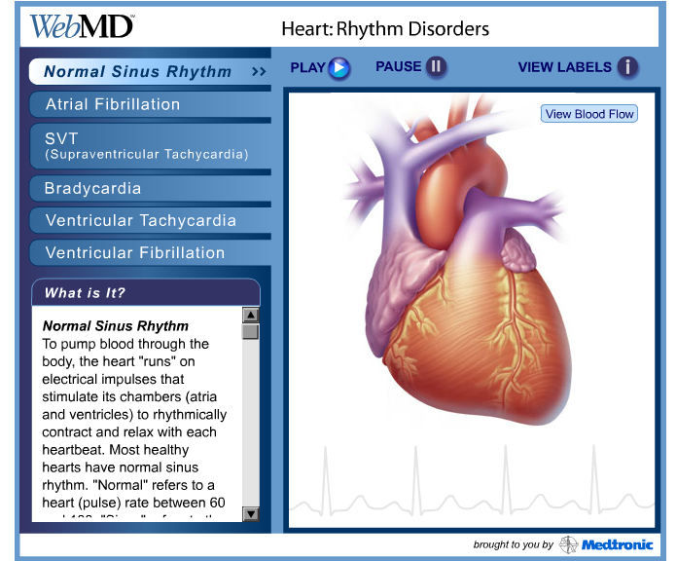
See animation
Notes:
This original source for this slide is a useful online tool at:
http://a1977.g.akamai.net/f/1977/1448/1d/webmd.download.akamai.com/1448/Anatom-E-Tools/Heart/Heart_Tool.swf
Show SR here.

Slide 8
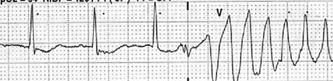
Many forms of heart disease can interrupt the normal contract-relax cycle and cause abnormally fast or slow heart rates.
Cardiac Arrhythmia: Irregularity of the heartbeat caused by damage to (or defect in) the heart tissue and its electrical system.
Sinus Rhythm Cardiac Arrhythmia

Slide 9
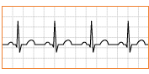

There are several different types of Cardiac Arrhythmias, some are not as severe, while others are considered life threatening.
Sinus Rhythm (normal heartbeat)
Ventricular tachycardia (VT) – the heart beats too fast and may not pump enough blood. Very dangerous and requires immediate treatment.
Paroxysmal supraventricular tachycardia (SVT) – The heart beats fast and may feel unpleasant. However, it is usually not life threatening and does not require treatment.

Slide 10
The Solutions

Slide 11
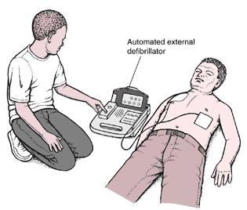
Before the 1960’s no treatment existed for cardiac arrhythmia.
The 1960’s saw the introduction of CPR, cardiopulmonary resuscitation.
External defibrillation also became a tool, using an electric shock to stop cardiac arrhythmia and restart the heart.

Slide 12
Implantable Cardioverter Defibrillators (ICD’s) were first introduced in the 1980’s.
These ICD’s were large and required major surgery to be implanted in the patient’s abdomen.
These devices were reserved only for the highest risk patients and only lasted 18 months after being implanted.

Slide 13
Today’s ICD devices are smaller and more effective than those used previously.
Require only simple, local surgery to be implanted in the chest.
Offer programmable therapy (varying degrees of electric shock): about 300 J in 4-12 msec
Battery life of up to 9 years.

Slide 14
ICDs versus Pacemakers. What’s the difference?
Pacemakers and ICDs are very similar, but they are not the same thing.
Pacemakers send electrical shocks to the heart in order to speed up a heart that is beating too slowly. These shocks are small and cannot be felt.
ICDs shock the heart in order to slow down and correct a heart beat that is too fast. These shocks are large and are described as ‘being hit in the chest’.

Slide 15

Today’s ICD devices allow people who have heart problems to live relatively normal lives.
Many people both young and old can develop heart problems as the result of disease, defects, or injury due to accidents.
Without treatment patients may not be able to be physically active and healthy. With an ICD device many patients are able to live normally
active lives.
In 2002 alone there were about
100,000 ICDs implanted in patients.

Slide 16
Technical Challenges

Slide 17
There are several technical challenges to consider when designing an ICD.
The ICD is constantly monitoring the heart rhythm and must be able to quickly and accurately detect abnormal rhythms.
and
are the primary criteria
for a good ICD
detection algorithm.
Speed
Accuracy

Slide 18
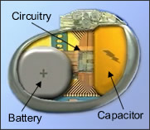
To be effective and practical an ICD must work continuously over a long period of time.
A balance must be established between speed and accuracy while keeping battery life in mind.
In general, faster algorithms are less accurate while slower algorithms are more accurate.
These tradeoffs are constrained by
possibility of death. An ICD cannot
miss a but it also has to be fast
enough to catch a in time.
VT
VT

Slide 19
An ICD that needs to be replaced every year is not very practical. Long battery life is essential to patients.
The battery life of an ICD depends on the complexity of the detection algorithm.
The more complex the algorithm the more power and time needed to make a decision.
The battery life also depends on the number of electrical shocks it sends to the heart.
Unnecessary shocks waste battery life and can be detrimental to the patient’s health.
Typical ICDs today are designed to have a battery life of approximately nine years.

Slide 20
The patient should only receive treatments when necessary, those shocks can hurt!
The detection algorithm must be complex enough to be accurate.
The heart rhythm from exercise can look very similar to the fast rhythm of a cardiac arrhythmia.

Slide 21

Algorithms must detect arrhythmias in real time.
The algorithm must be able to correctly distinguish between VT, SVT and exercise.
are dangerous and require electrical shock therapy.
and exercise are not dangerous and do not need therapy.
The algorithm must be complex enough to distinguish between these but not so complex that it is too slow and uses too much battery life.
Balance is key!
VT
SVT

Slide 22
Our Project
Develop a MATLAB program to analyze actual electrocardiogram (ECG) signals and determine whether they are dangerous, life-threatening ventricular tachycardias (VT) or the more benign supraventricular tachycardias (SVT).
VT
SVT

Slide 23
Cardiologists are trained to classify ECGs as either VT (requires treatment) or SVT (doesn’t require treatment). We need to create an algorithm that allows the ICD to do what a doctor would do.
The algorithm must be able to differentiate between different types of arrhythmias (VT and SVT).
The algorithm must be accurate enough to safely replace the intuition and experience that doctors possess.

Slide 24
Let’s zoom in to the 80 mS before and after the QRS pulse in an ECG from VT and SVT. What is difference between these pulses?

Slide 25
Let’s also look at the derivative of the QRS pulse for VT and SVT.

Slide 26
The time of the first peak (called the onset time) in the derivative of the ECG signal tends to occur sooner for VT than in SVT
SVT
First peak
at -20mS
VT
First peak
at -40mS

Slide 27
Each of the ECG test signals in this project have three peaks. The program needs to detect all three.

Slide 28
Overview of the Derivative Method
Locate the three peaks from one of the ECG signals
Extract the 80ms interval before each peak
Calculate the derivative of each of the three 80ms intervals
Compute the average of the three derivatives
Find the time of the first peak in the average signal (onset time)
If the onset time is less than a certain threshold value (to be determined), classify as VT and print ‘VT (Treatment needed!!)’
If the time is greater than a certain threshold value, classify as SVT and print ‘SVT (No treatment needed)’

Slide 29
After the onset times for all of the known signals have been computed, calculate the threshold value as follows:
$$threshold=\frac{\left(\max{onset time VT}\right)+\left(\min{onset time SVT}\right)}{2}$$
ECG Signal Name | Classification | Onset Time (ms)
vt1 | VT | -72
vt2 | VT | -32
vt3 | VT
vt4 | VT
vt5 | VT
svt1 | SVT | -24
svt2 | SVT | -24
svt3 | SVT
svt4 | SVT
svt5 | SVT
Then use this threshold
to classify the
unknown ECG
signals!
NOTE: our ECG
signals are from patients and have been classified by cardiologists

Slide 30
How to Load the Data
Download the file ECG_data.mat from the course website and load it into MATLAB
The following variables are included in the file:
T: sampling interval (0.008 Sec or 8 mS)
vt1 through vt5: known signals classified as VT
svt1 through svt5: known signals classified as SVT
unknown1 through unknown9: Unknown signals for you to classify

Slide 31
How to compute the derivative (slope) of a discrete-time signal.
slope = ______ = ___________
run
x(t₂)
rise
x(t₂) – x(t₁)
x(t₁)
t₂ - t₁
t₁
t₂
We can use the MATLAB function gradient to compute the derivative of a signal.

Slide 32
How to locate the peaks
The MATLAB function findpeaks will return the location of the peaks.
Example (finds all of the peaks):
load ECG_data.mat
[p,in] = findpeaks(vt3);
ind = 1:length(x);
plot(in,x,ind(in),x(in),'o')
See the plot on next slide…

Slide 33
Too Many Peaks!

Slide 34
The findpeaks command can limit the peaks to those above a minimum height (MINPEAKHEIGHT) and those that are more than a minimum distance from each other (MINPEAKDISTANCE) so that it only returns the three largest peaks. See the help file for details.

Slide 35
The mean command can be used to compute the mean of several vectors.
Example (row vectors):
>> x1 = [1 2 3];
>> x2 = [4 5 6];
>> mean([x1; x2])
ans =
2.50 3.50 4.50
Example (column vectors):
>> x1 = [1; 2; 3];
>> x2 = [4; 5; 6];
>> mean([x1 x2], 2)
ans =
2.50
3.50
4.50

Slide 36
How to Proceed
Load the data
Graph a few of the ECG signals to examine them
Write a function to compute the onset time of an ECG signal
Compute the onset time for the known signals (vt1 through vt5 and svt1 through svt5)
Compute the threshold value
Write a function that classifies an ECG signal, and test it on the known signals
Classify the unknown signals

Slide 37
Let us know if you have any questions.

